Slide 1

Demystifying AI: Personalized projects to boost student creativity
Ayush Pandey
Electrical Engineering
March 14, 2025

Slide 2
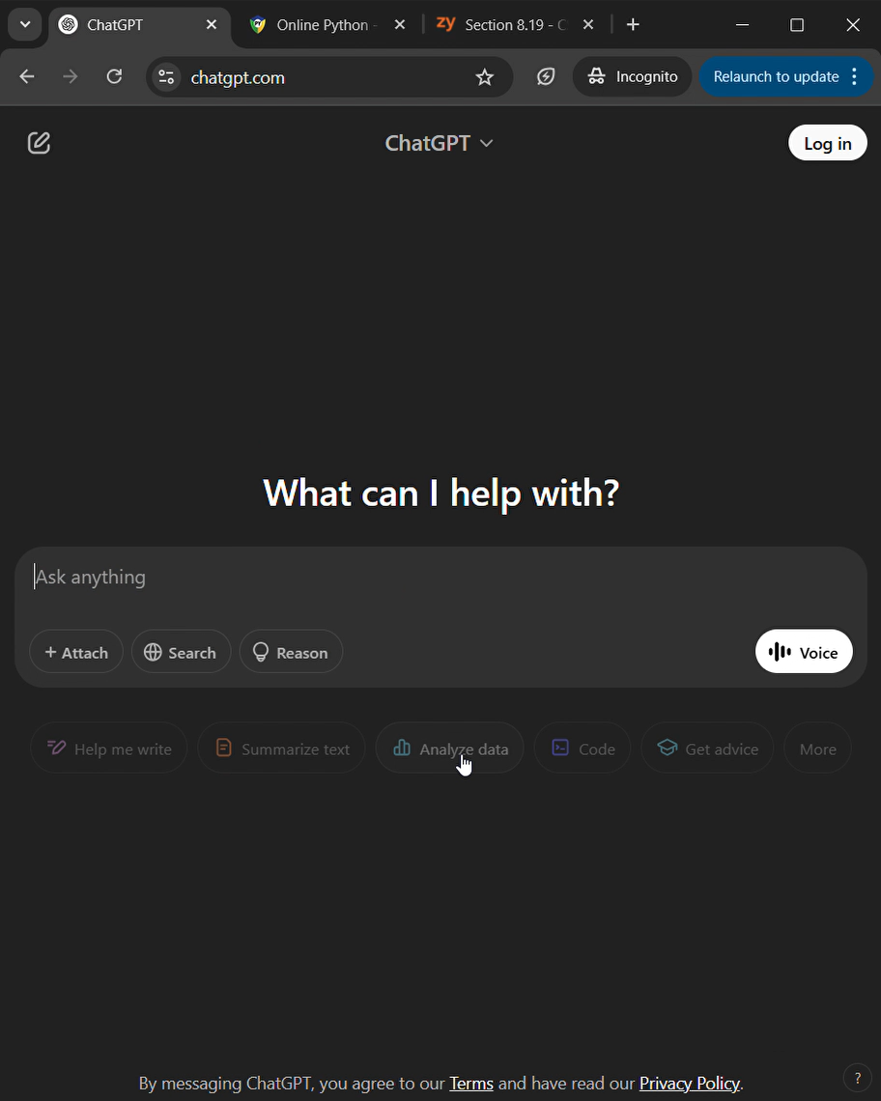
Code generating LLMs are excellent for CS1
Conventional CS1 assignment
Write a Python program that gets a list of integers from input, and outputs negative integers in descending order (highest to lowest).
Ex: If the input is:
10 -7 4 -39 -6 12 -2
the output is:
-2 -6 -7 -39
AI-enabled homework pipeline

Slide 3
AI for learning and learning with AI
Assessments that are:
Personalized. Open-ended. Flexible.
Discourage the use of AI?
Use paper-pencil exam!
In-person Q&A and presentations
Use pictures and videos for HW
In summary,
Innovate your assessments
…but how?
Formative
Milestone 1: Set up computers
Summative
Demonstration #1: Oral exam
Milestone 2: Propose project idea (or choose)
Milestone 3: Create the framework and I/O structure
Milestone 4: Integrate loops and required logic
Milestone 5: External data and personalize
Demonstration #2: Class/lab presentation
Demonstration #3: Skill quiz
Final project submission: All files + cover sheets
Grading rubric
User-friendly? | Technical rubric items | Does the code run? | Is it well documented? | Did it solve the proposed problem?
10 points | 40 points | 20 points | 10 points | 20 points

Slide 4
AI for learning and learning with AI
But…
Can you do it in larger classes?
Does it scale well?
How do you grade this fairly?
Assessments that are:
Personalized. Open-ended. Flexible.
Discourage the use of AI?
Use paper-pencil exam!
In-person Q&A and presentations
Use pictures and videos for HW
In summary,
Innovate your assessments
…but how?
Formative
Milestone 1: Set up computers
Summative
Demonstration #1: Oral exam
Milestone 2: Propose project idea (or choose)
Milestone 3: Create the framework and I/O structure
Milestone 4: Integrate loops and required logic
Milestone 5: External data and personalize
Demonstration #2: Class/lab presentation
Demonstration #3: Skill quiz
Final project submission: All files + cover sheets
Grading rubric
User-friendly? | Technical rubric items | Does the code run? | Is it well documented? | Did it solve the proposed problem?
10 points | 40 points | 20 points | 10 points | 20 points

Slide 5
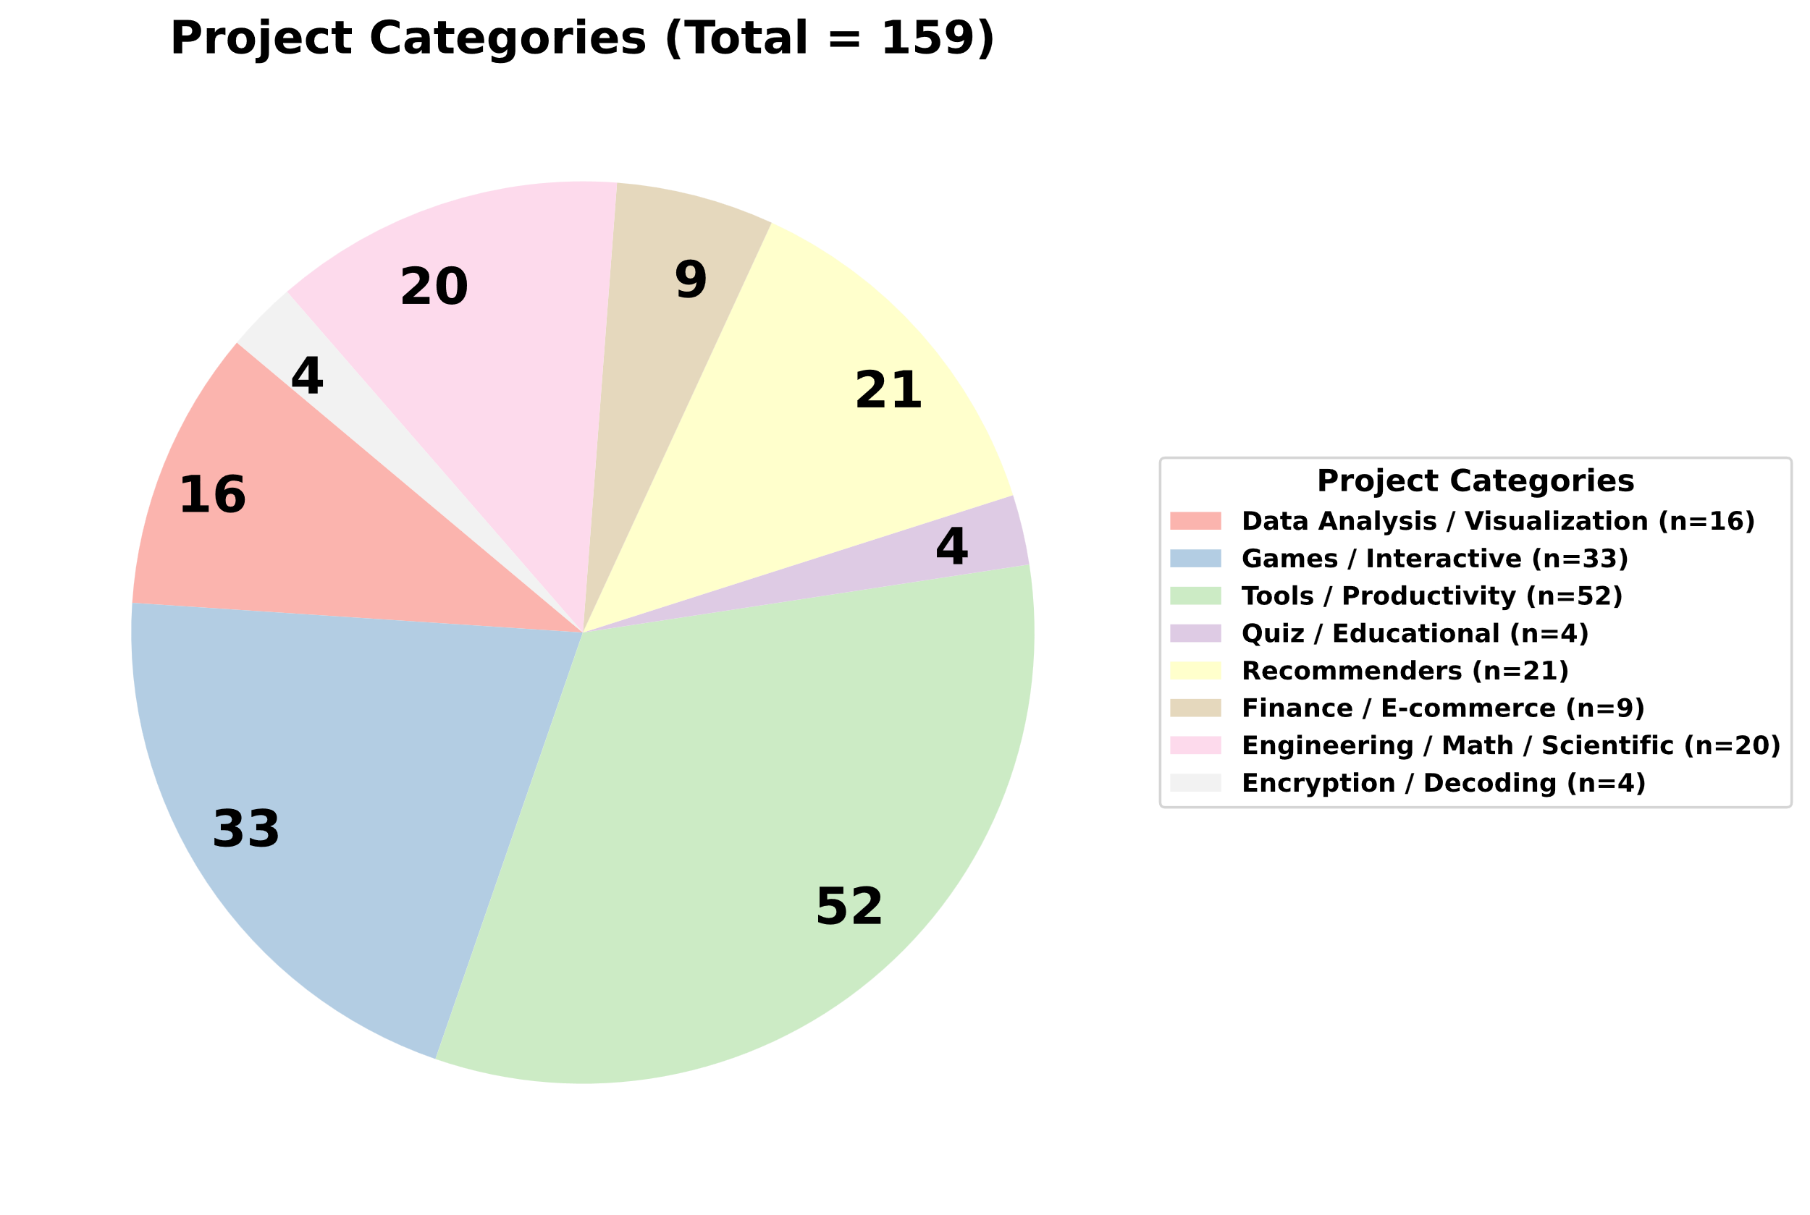
AI for learning and learning with AI
Assessments that are:
Personalized. Open-ended. Flexible.
Answer to some of those questions is: YES!
Near peer mentors (LAs) are critical for success with personalized classes
Promoting student creativity at the proposal stage
A flexible AI-grader (Flexigrader) that can grade open-ended assignments reliably with subjective rubric
Data from Fall 2023 ME 021

Slide 6
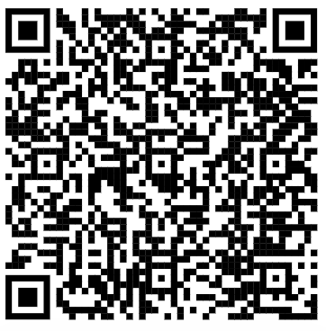

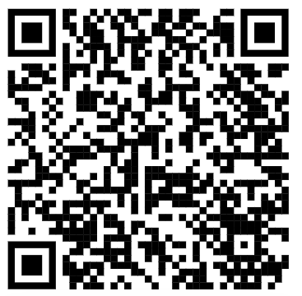
Open educational resources
List of all projects
Student feedback
Flexi-grader

